Slide 1
ADHD Medication
The next “pill to pop”

Slide 2
Attention deficit Hyper-Activity disorder
Origins
First described in 1798 by Alexander Crichton as a “morbid diminution [attentions] power or energy” and “the incapacity of attending with necessary constancy to any one object”
British pediatrician George Still described children with “problems with sustained attention and self regulation, were aggressive and had little inhibitory volition”
Notes:
Psychology was still in its early stages, first psychology lab was founded in 1879, and psychological illnesses were still classified as “insane or idiotic”
Crichton and Still believed that these dysfunctions were caused by illness or disease or inheritance of bad genes.
It wasn’t until 1918 that mental illness was formally described by the American Psychiatirc Association and the National Commission on Mental Hygiene

Slide 3
Attention deficit Hyper-Activity disorder
The Diagnostic and Statistical Manual of Mental Disorders
DSM
Formally published by APA in 1952
Listed 106 mental disorders
DSM-IV – Attention Deficit Hyper-Activity Disorder
Inattention
Hyperactivity-impulsivity
Notes:
DSM provided common language and criteria for classification and diagnosis of mental disorders
Revised many times to add additional criteria as they are found
In the revisions leading up to DSM-IV they added, hyperkinetic reaction and variations of the diagnosis that is used today
DSM-IV describes two subtypes of ADHD, which each have their own criteria

Slide 4
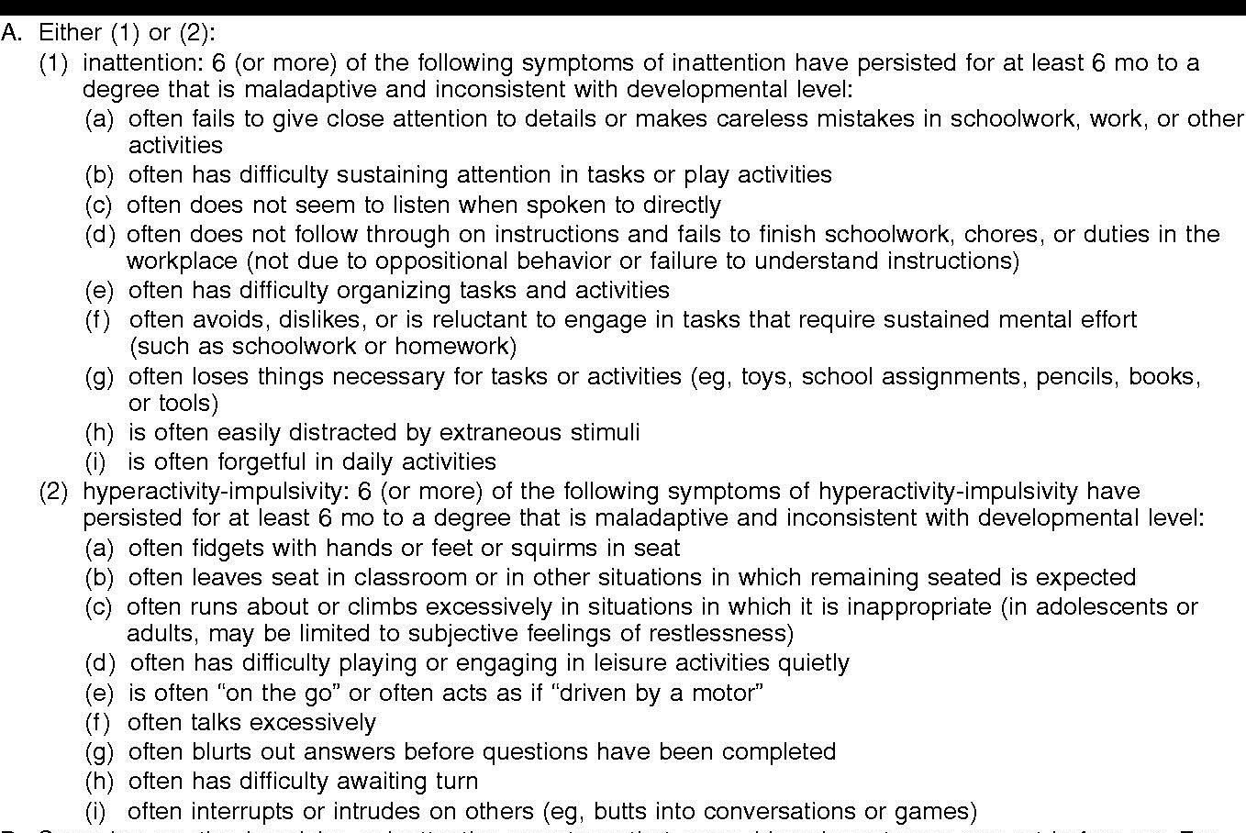
Criteria for ADHD diagnosis
Notes:
Point out:
For both inattentive/hyperactive-impulsive need 6 or more of the criteria for diagnosis

Slide 5
Prevalence of ADHD
ADHD affects 4.5 million children in the US, or 7.8% of the school aged population
A study of 1,080 college students found that 12.3% of them were on the clinical range for ADHD
The National Center for Educational Statistics found that 29% of the population of students enrolled in a 2 or 4 year University have ADHD
Notes:
12.3% - only 2% of those students were actually diagnosed with ADHD, the other 10.3 % could have the diagnosis, but had not seen a professional

Slide 6
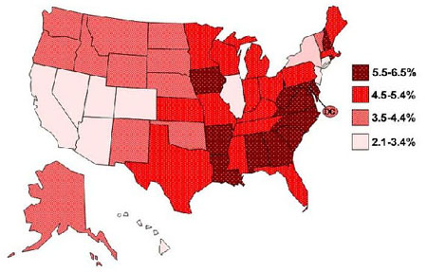
Notes:
Prevelance in the US from 2005

Slide 7
Economics of treating adhd
It has been estimated that the annual “cost of illness” for ADHD is $12,005 - $17,458 per individual.
ADHD medication ranges from and $11 monthly cost for a generic medication to $1,381 a month
Notes:
Excess costs of a persons with ADHD in the US in 2000 was $16.3 billion
98 different types of drugs, differing in stength, dosage, and relase type

Slide 8
So what’s the issue?
The Study Pill
Full time college students are twice as likely to use Adderall nonmedically than students of the same age not in college
College students who used Adderall nonmedically vs. those who have not used Adderall:
3x’s more likely to have used marijuana
8x’s more likely to have used cocaine
8x’s more likely to have been nonmedical users of prescription tranquilizers
90% of users were binge drinkers, and 50% were heavy alcohol users

Slide 9
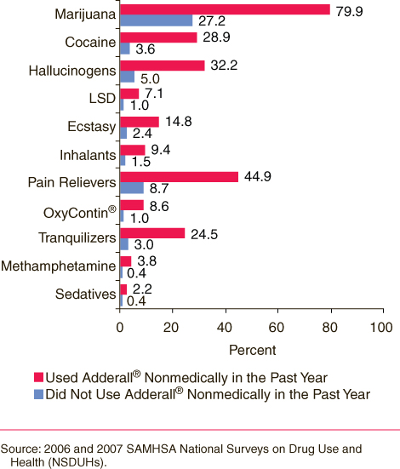
Other drug use and nonmedical use of Adderall
Notes:
According to a 2005 study, teens who abuse prescription drugs are 12 times likelier to use
heroin, 15 times likelier to use Ecstasy and 21 times likelier to use cocaine, compared
to teens who do not abuse such drugs

Slide 10
Repercussions of ADHD medication abuse
More than 1.6 million teens and young adults misused ADHD medication and 75,000 became addicted
Calls to the Poison Control Center due to misuse of ADHD medication rose from 330 in 1998 to 581 in 2005
Symptoms of Adderall overdose:
Fast Breathing
Confusion
Fever
Aggressiveness
Hallucinations
Notes:
76% increase

Slide 11
Cont.
Effects of Ritalin
When used outside of a doctor’s care, Ritalin can be habit forming and cause physical reactions such as:
Irregular heartbeat
Dangerously high body temperature
Potential for cardiovascular failure
Seizures
Hostilities
Paranoia
Verbal tics
Withdrawal Symptoms
Fatigue
Insomnia
Increased appetite
Notes:
These medications also have a high risk of building a tolerance
Because a tolerance builds up, abuse of Ritalin can lead users to consume stronger drugs to achieve the same high. When the effects start to wear off, the person may turn to more potent drugs to rid himself of the unwanted conditions that prompted him to abuse the drug in the first place.

Slide 12
Legal issues
In the United States, Ritalin is subject to severe criminal penalties for abuse. The penalties for a first trafficking offense includes up to 20 years in prison and a fine of up to $1 million.
If death or serious injury results from a first offense, the penalty is 20 years to life in prison. If the drug is injected, it becomes a drug offense with even harsher penalties.
Notes:
Trafficking offense which you would be guilty of even if you just shared one or two pills with a friend

Slide 13
Why is medication abused?
Rabiner et al (2008) conducted a study about reasons behind nonmedical use of ADHD medication and the top 5 responses were:
To concentrate better while studying
To be able to study longer
To feel less restless while studying
To concentrate better in class
To keep better track of assignments
Notes:
Only 6% used the medication for a nonacademic reason
Students also reported being able to concentrate better in class as well as being able to study longer

Slide 14
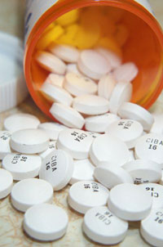
Notes:
I would hope that this has shown the need for different treatments of ADHD to reduce the availability of the medication, and reducing the potential for misuse/abuse

